Slide 1
Case Study Title
CRM CASE STUDY

Slide 2
Name
Personal Info
Etc.

Slide 3
Question Policy

Slide 4
Overview
Objectives
Critical Skills Review
Case Study Focus Skill
Synopsis
Focus Questions

Slide 5
Objectives
Terminal Objective
Enabling Objective

Slide 6
Crew Resource Management
Allows crew to interact effectively while performing mission tasks
A program to effect behavior modifications in order to prevent human factor and crew preventable errors
To improve mission effectiveness through increased awareness of associated behavioral skills
What does CRM mean to me?

Slide 7
CRM Critical Skills Review
Decision Making (DM)
Assertiveness (AS)
Mission Analysis (MA)
Communication (CM)
Leadership (LD)
Adaptability/Flexibility (AF)
Situational Awareness (SA)

Slide 8
Case Study Focus Skill
LEADERSHIP
The ability to direct and coordinate the activities of crewmembers and to encourage them to work together as a team

Slide 9
Types of Leadership
Designated Leadership
- Leadership by authority, crew position, rank, or title
- Normal mode of leadership
Functional Leadership
- Leadership by knowledge or expertise
- Temporarily allows for most qualified
individual to take charge of the situation

Slide 10
Responsibilities of Leaders
Direct and coordinate the crew’s activities
Delegate tasks
Ensure crew understands what is expected of them
Focus attention on crucial aspects of the situation
Keep crew informed of mission information
Ask crew for mission relevant information
Provide feedback to the crew on their performance
Create and maintain a professional atmosphere

Slide 11
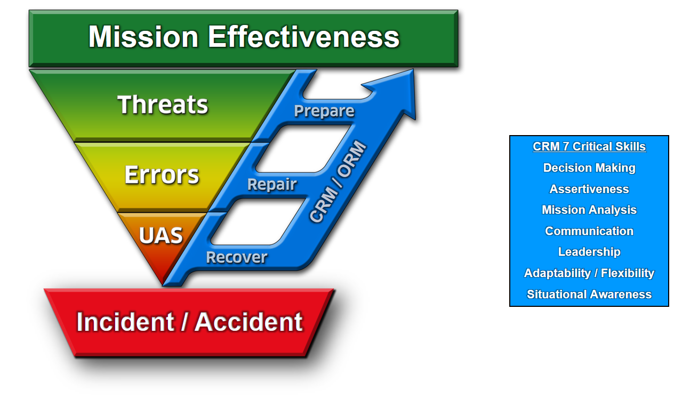
Threat and Error Management
TEM is what we do. CRM is how we do it.
Notes:
MASTER TEM SLIDE

Slide 12
Why Threat & Error Management?
In the past: We focused on eliminating human error in aviation.
Contemporary acknowledgement: Errors are inevitable, so…
We must instead focus on ways to effectively MANAGE and REDUCE errors

Slide 13
Mission Effectiveness
MISSION EFFECTIVENESS

Slide 14
Mission Effectiveness
MISSION EFFECTIVENESS
What is a mission?

Slide 15
Mission Effectiveness
MISSION EFFECTIVENESS
A Mission is the Task + Purpose

Slide 16
Mission Effectiveness
MISSION EFFECTIVENESS
How is Effectiveness defined?

Slide 17
Mission Effectiveness
MISSION EFFECTIVENESS
How is Effectiveness defined?
Completing the task to specific standards:
Time / Cost / Quality

Slide 18
Mission Effectiveness
MISSION EFFECTIVENESS
Mission Effectiveness is completing the task to specific standards in order to fulfill the purpose.

Slide 19
Mission
MISSION EFFECTIVENESS
Task + Purpose

Slide 20
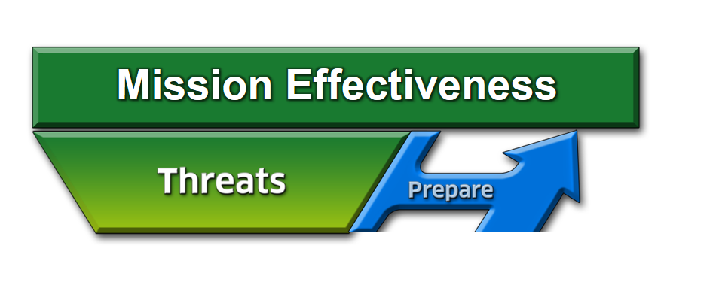
Threats
A THREAT is anything that increases operational complexity that, if not managed properly, can decrease the safety margins.

Slide 21
Threats
How do we operate in spite of the fact that we cannot eliminate the THREATS from aviation?
Effectively PREPARE for and manage them
21 of 20
Notes:
21

Slide 22
Threats
What is our strategy to manage threats?
Identify and PREPARE

Slide 23
Strategies to Prepare for Threats
Things we can use to counter threats:
ORM
Clearly defined roles of aircrew members
Complete briefing and effective communication
Limit being “heads down” at critical times
NATOPS / System Knowledge
CRM
Notes:
23

Slide 24
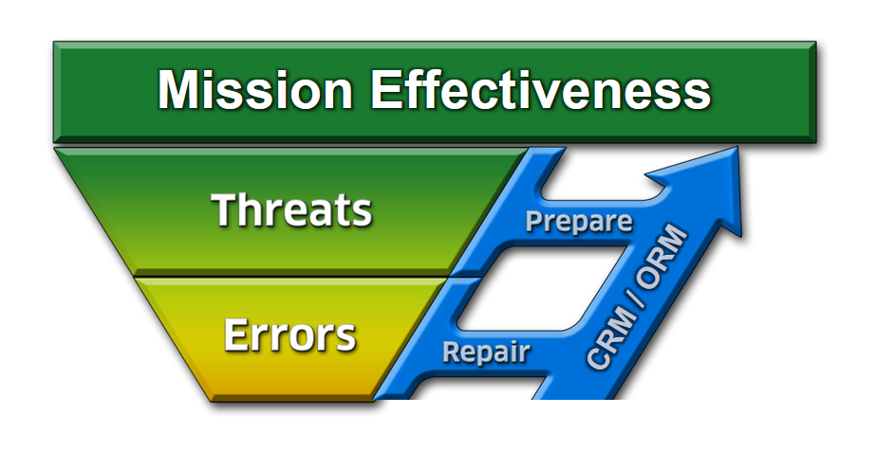
Errors
What can happen if we ignore or mismanage a THREAT?
24 of 20

Slide 25
Definition of Error
Error:
Crew action or inaction that leads to deviations from expectations and reduces safety margins
May occur from either mistakes or mismanaged threats
Error Management:
Process of correcting an error before it becomes consequential, i.e. Undesired Aircraft State and Incident/Accident
Notes:
25

Slide 26
Categories of Errors
Procedural - Following procedures but wrong execution (wrong altitude on course rules)
Communication - Missing info or misinterpretation (miscommunication with ATC)
Proficiency - Error due to a lack of knowledge/currency (night TERF/DVE landings)
Decision - Crew decision unbounded by procedures that unnecessarily increased risk (unnecessary navigation through adverse wx)
Intentional Noncompliance - Violations (AOB exceedances)
Notes:
26

Slide 27
Strategies for Errors
What is our strategy to manage errors?
CRM 7 Critical Skills
Decision Making
Assertiveness
Mission Analysis
Communication
Leadership
Adaptability / Flexibility
Situational Awareness
Identify and REPAIR
27 of 20

Slide 28
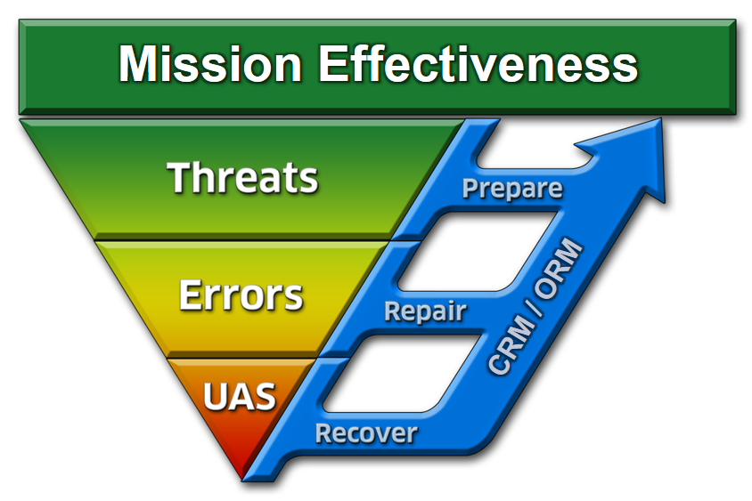
What if We Don’t Repair the Error?
Undesired Aircraft State: A position, speed, attitude, condition, or configuration of an aircraft that reduces safety margins.
28 of 20

Slide 29
How to Manage an Undesired Aircraft State
Identify and RECOVER
Notes:
29

Slide 30
Synopsis

Slide 31
Threat and Error Management
TEM is what we do. CRM is how we do it.
Notes:
MASTER TEM SLIDE

Slide 32
Focus Questions
What threats came “at” the crew and what strategies were used to prepare for threats and initially deal with them?
What errors came “from” the crew and how did they use leadership to repair the errors?
What undesired aircraft state was achieved and how did the crew recover?

Slide 33
Mission Effectiveness
MISSION EFFECTIVENESS
What is the mission?

Slide 34
Focus Question #1
What threats came “at” the crew and what strategies were used to prepare for threats and initially deal with them?

Slide 35
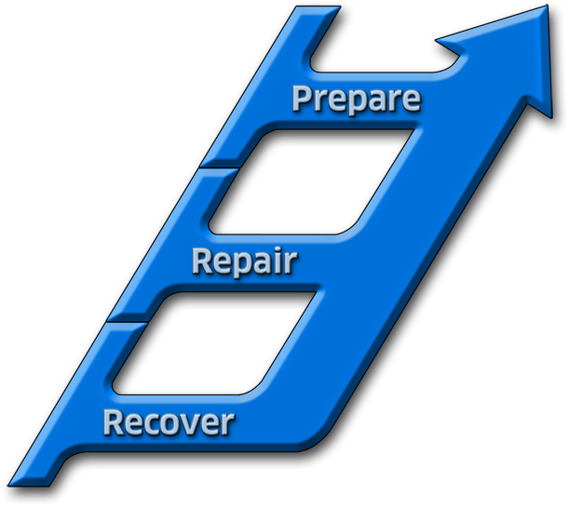
Focus Question #2
What errors came “from” the crew and how did they use LD to repair the errors?
Mission Effectiveness
CRM 7 Critical Skills
Decision Making
Assertiveness
Mission Analysis
Communication
Leadership
Adaptability / Flexibility
Situational Awareness
CRM / ORM
Identify and REPAIR
Notes:
MASTER TEM SLIDE

Slide 36
Focus Question #3
What Undesired Aircraft State was achieved and how did the crew recover?

Slide 37
Remember
Leadership is not solely the responsibility of the pilot, each crew member has specialized duties and qualifications
It is the leader’s responsibility to ensure the crew works together as a team
Feedback should be given on both good and bad performance

Slide 38
Questions?

Slide 39
Mission Effectiveness
CRM 7 Critical Skills
Decision Making
Assertiveness
Mission Analysis
Communication
Leadership
Adaptability / Flexibility
Situational Awareness
CRM / ORM
Incident / Accident
Notes:
MASTER TEM SLIDE

